Slide 1


Slide 2
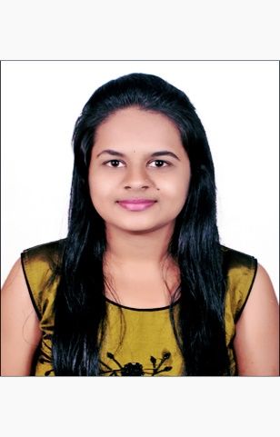
Project Highlights
Project Name : BurgerBuddies
Team Size : 1
BU Mentor Name : Samyukta Mentor PS:20033200
Hemalatha R
99002622
2009BLRMED01
B.E Computer Science and Engineering

Slide 3
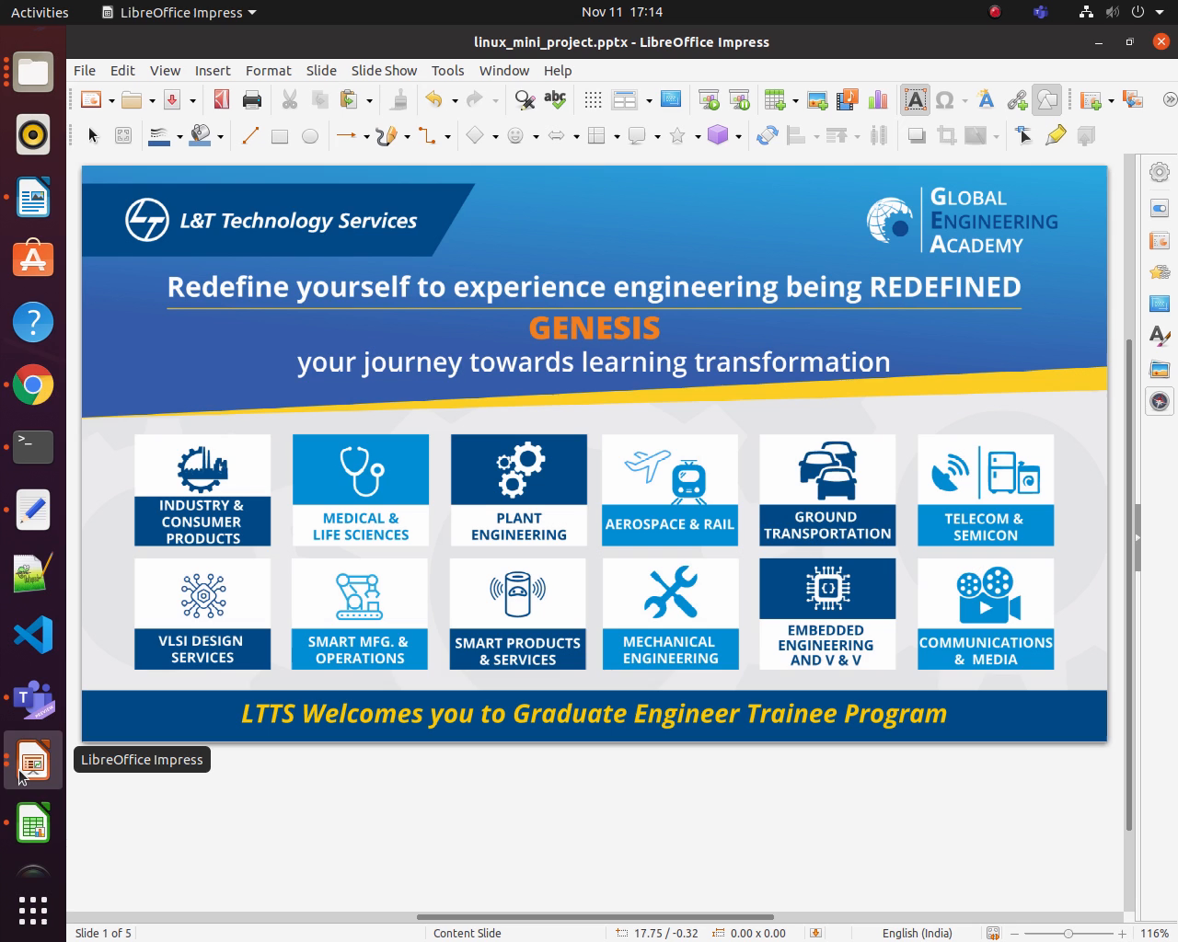
Project Video Snippet

Slide 4
Future development that can be implemented further
In this project we have not used any synchronization in future it can be implemented while serving the burger with many customer to maintain the process accurately.

Slide 5


Thank You !

